Slide 1
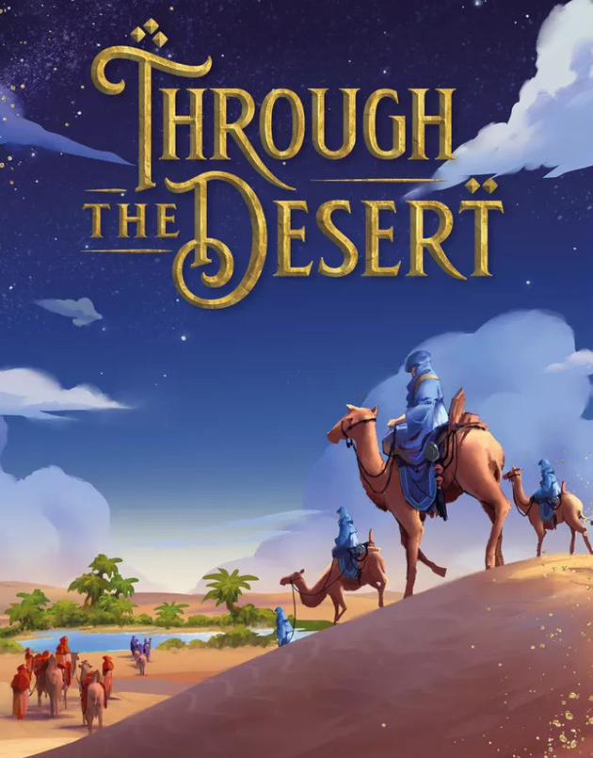
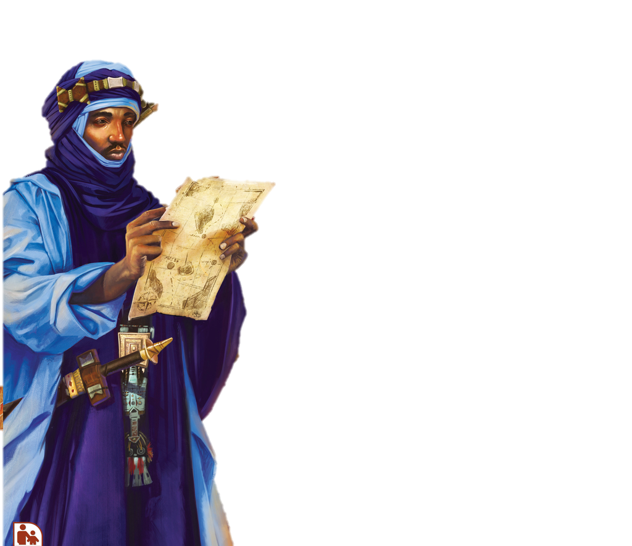
2-5players
Setup:
Choose a side of board, 2-3players don’t use shaded area.
Put palm trees on oases.
Put point tokens on watering holes and remaining oases.
Give each player their riders to put on 1 of each colour camel
The grey camel is to remember what colour you are.
Now: Take turns to place 1 rider each around map
*This can’t be on a watering hole, next to an oasis or another rider.
Play:
Twice, place a camel of the correct colour
next to one of your growing camel trains
(you can branch off mid train).
*You cannot touch caravans of the same colour
as another player.
*You cannot go onto an oasis.
Score:
+5 points the 1st time your train
touches each oasis, or crosses the river.
+The Token value if go onto a watering hole.
And also at the end of the game:
+10 points for the longest train of each colour
(5 if tied).
+1 point per hex plus everything inside an area
completely enclosed by one of your trains
(this maybe against rocks or edge).
Game ends:
When the supply of 1 colour of camel is gone.

