Slide 1
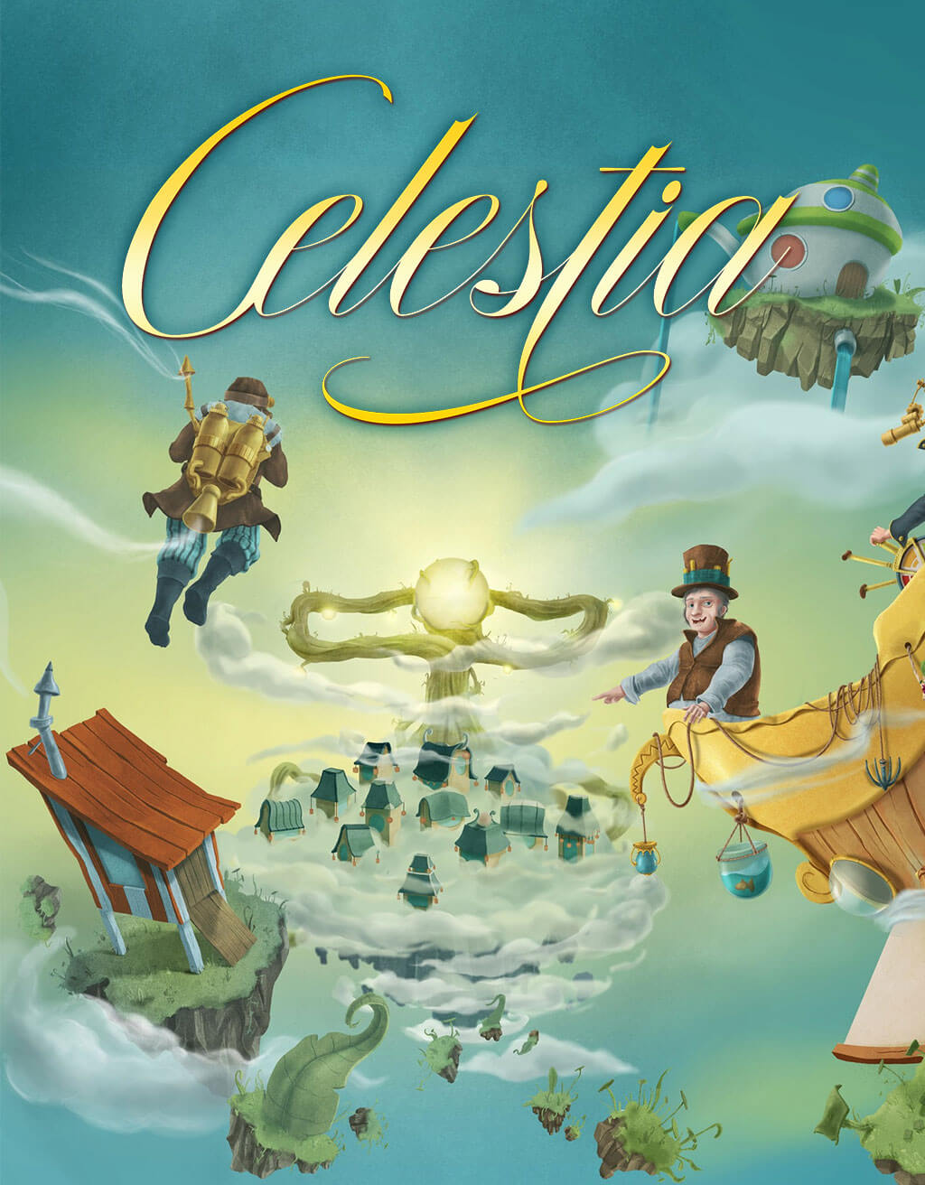
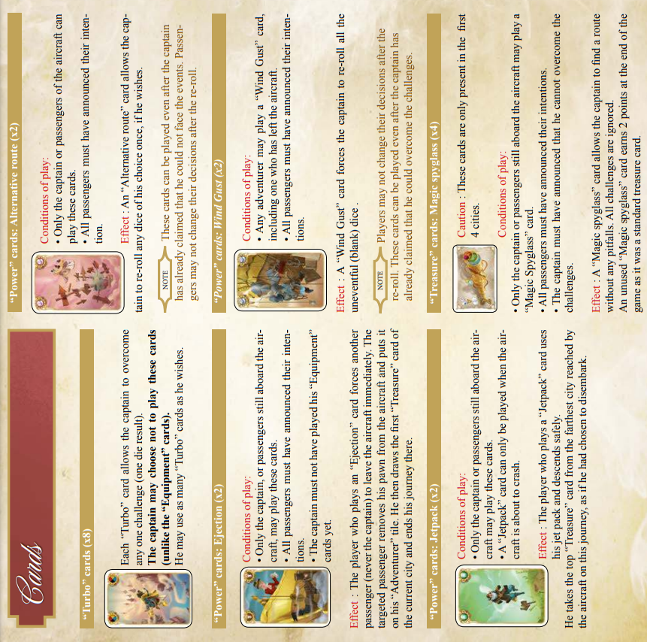
2-6 Players
2-5 Players
Setup:
Place the 9 city tiles in ascending order.
Stack each set of shuffled facedown treasure cards next to its city.
Place the aircraft on the first city.
Each player chooses a pawn and same-colour Adventure tile.
Shuffle all Equipment, power and Turbo cards together and deal each player 8 cards (2-3players), 6 cards (4+ players).
Place remaining cards facedown in middle as an “Equipment” deck.
Play:
One leg of the journey is composed of five steps:
The captain rolls as many dice as indicated for the city to determine the challenges.
Blank – no equipment card required.
Cloud – requires a compass
Lightning – requires arrester
Birds – requires foghorn
Swords – requires cannon
Each passenger chooses to stay aboard or disembark depending on if they think the captain has the equipment to overcome the dice.
  Take your pawn out of the aircraft
  Take the top treasure card of this city’s deck
The captain faces the challenges.
  All players may play power cards.
  The captain must play equipment cards (Turbo cards are optional) – one per die.
a) If the captain has overcome the dice, they move the aircraft to the next city. Discard all played cards.
b) If the captain cannot overcome the dice, they play no equipment cards. The journey ends and no-one still aboard gains any treasure.
The captain passes the control of the aircraft to the next player (to their left). Place the aircraft back on the 1st city. Return all pawns to the aircraft. Each player draw a card from the equipment deck.
End of Game: Before the beginning of a new journey, if any player has reached 50 points, the highest total wins.

